Slide 1
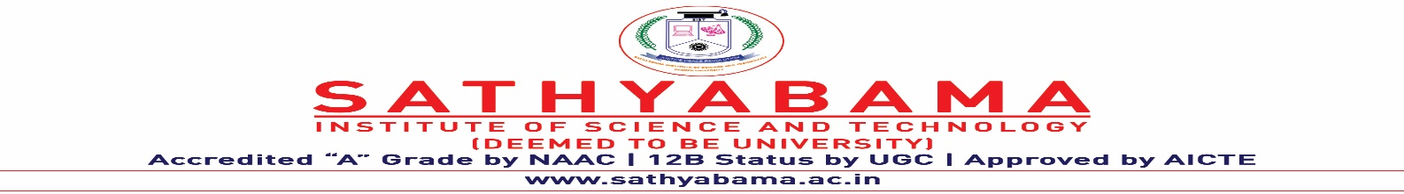
REAL-TIME SIGN LANGUAGE DETECTION TO TEXT LANGUAGE CONVERSION USING OPENCV AND TENSORFLOW
Under the guidance of
Ms. K. Karunya, M.E
by
Harrishkumar. L
(40110443)
Hashwanth Kumar. H
(40110449)

Slide 2
Presentation Outline
Aim of the project
Abstract
Introduction
Literature Survey
Process Flow
Basic Requirements
Existing Model and Methodology
Proposed Model and Methodology
Project Management Plan
References

Slide 3
Aim of the project
To develop a real-time sign language detection to text language conversion system that utilizes machine learning with TensorFlow and computer vision with OpenCV to recognize and convert sign language gestures into text language providing a more accessible means of seamless communication for the deaf and hard of hearing community.

Slide 4
Abstract
The existing Indian Sign Language Recognition systems are designed using machine learning algorithms with single and double-handed gestures but they are not real-time. In this project, we propose a method to create an Indian Sign Language dataset using a webcam and then using transfer learning, train a TensorFlow model to create a real-time Sign Language Recognition system. The system achieves a good level of accuracy even with a limited-size dataset.

Slide 5
Introduction
Communication is defined as the act of sharing or exchanging information, ideas or feelings.
To establish communication between two people, both of them are required to have knowledge and understanding of a common language.
But in the case of deaf and dumb people, the means of communication are different. Deaf is the inability to hear and dumb is the inability to speak.
They communicate using sign language among themselves and with normal people but normal people do not take seriously the importance of sign language.

Slide 6
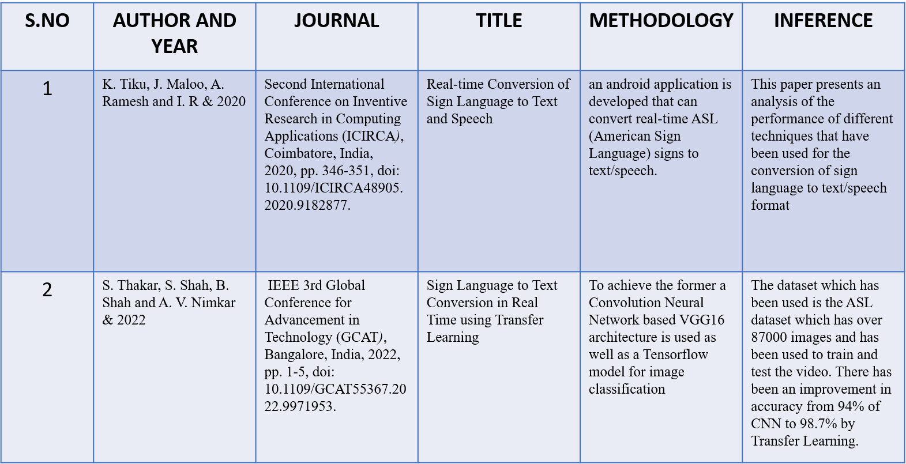
Literature Review

Slide 7
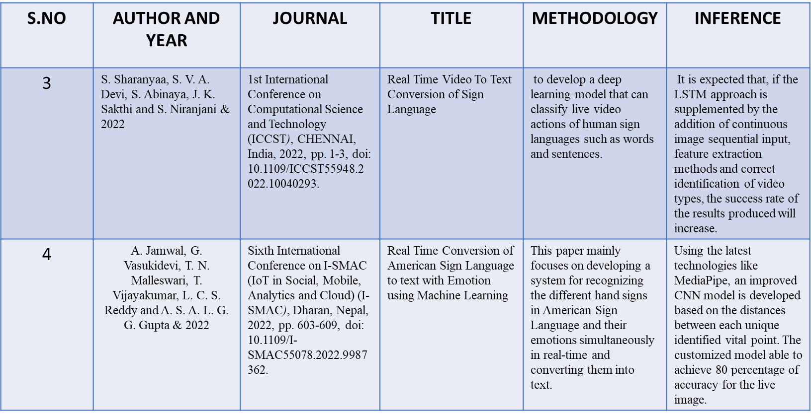
Literature Review

Slide 8
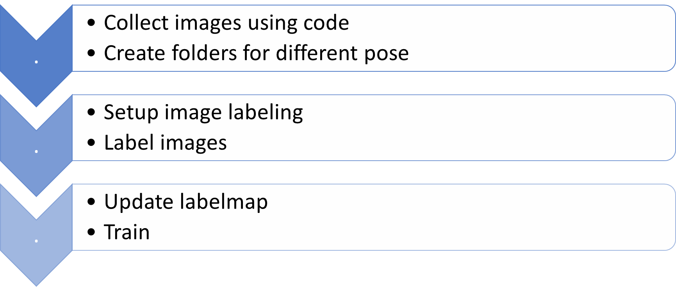
Process Flow

Slide 9
Basic Requirements
Windows more than 8
Minimum 4GB Ram
Python (3.7.4)
IDE (Jupyter notebook)
Numpy (version 1.16.5)
CV2 (OpenCV)
Keras
Tensorflow (as Keras uses TensorFlow in the backend and for image preprocessing)

Slide 10
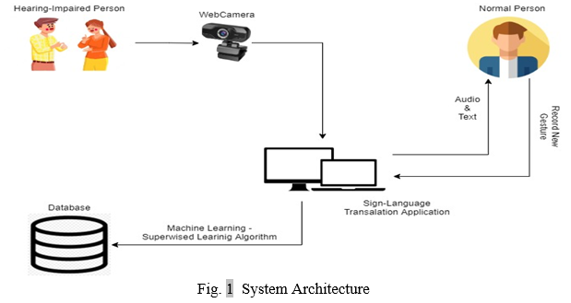
System architecture

Slide 11
Existing Model
Data collection
Sign language dataset
Text language dataset
Data preprocessing
Model training
Sign language to text translation
Output

Slide 12
Methodology of the existing model
In this model, the images of the sign language and text language are taken already.
They are stored in different folders and they are being processed using a geometric approach, an image processing technique to identify different facial expressions based on the distinguished key points on a face.
The images are considered in pixel format and are processed using the deep neural network-based approach for any kind of feature extraction.
The outputs of will be compared with the corresponding ideal values that are stored in a database.

Slide 13
Proposed Model
Collect images using program
Save them in different folders
Use labeling to label the images based on their meaning
Update the labelmap
Download the Tensorflow pretrained models
Copy Model Config to Training Folder
Update Config For Transfer Learning
Train the model
Detect in real time

Slide 14
Methodology of the proposed model
In this model, the images of the sign language is taken with the help of the program which sends the images to the assigned locations.
After that, with the help of the labeling program label the images with their appropriate meaning.
Then the dataset is divided into testing set, training set, and validation set.
Later, the model is being trained by the Tensorflow and CNN algorithm.
Finally, it is being tested on live detection with the help of the web camera.

Slide 15
Import libraries

Slide 16
Setting up image path

Slide 17
Setting array for label

Slide 18
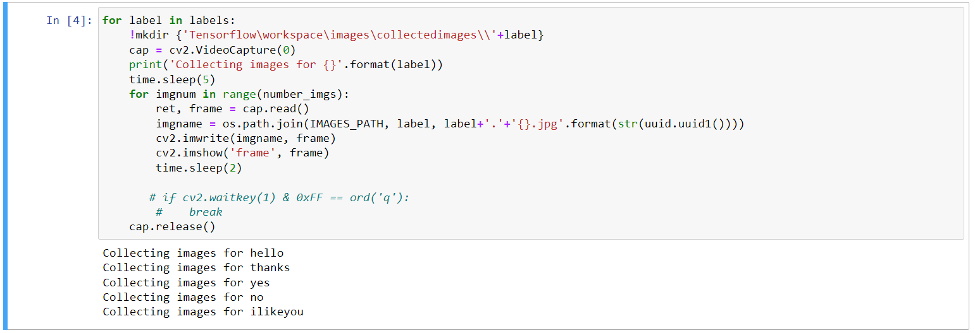
Code to collect the images

Slide 19
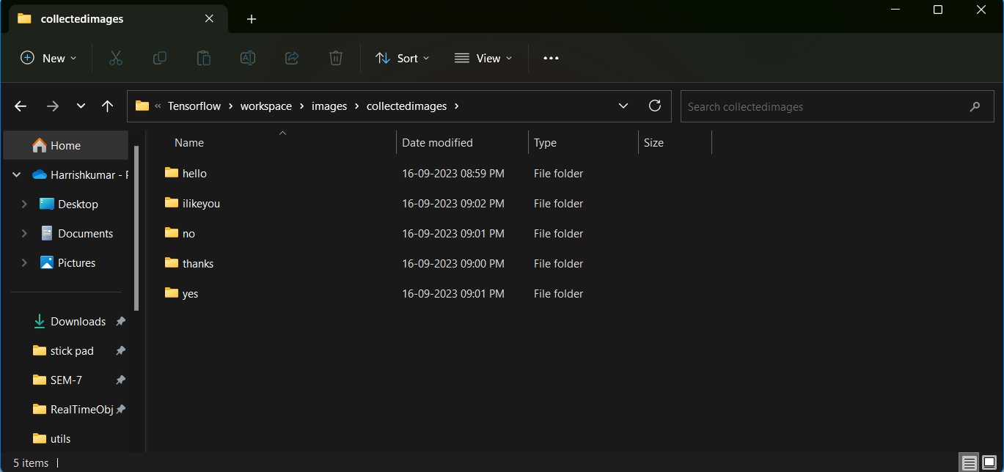
Images are stored in folders

Slide 20
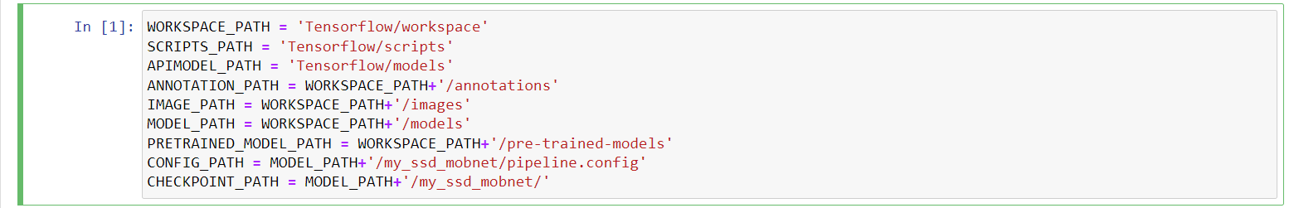
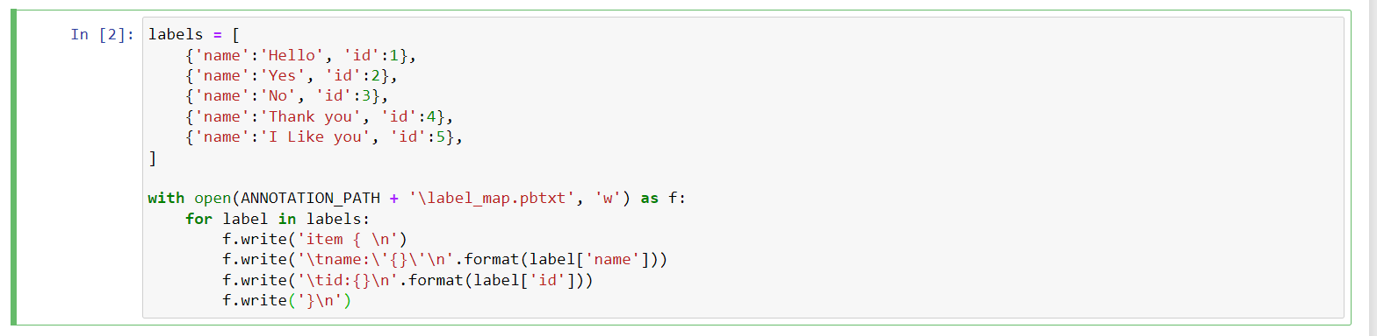
Paths and labels are set

Slide 21
TensorFlow models are cloned

Slide 22
Importing TensorFlow and pipeline

Slide 23
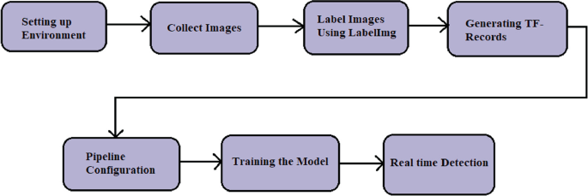
Steps for TensorFlow model

Slide 24
Configuring pipeline

Slide 25
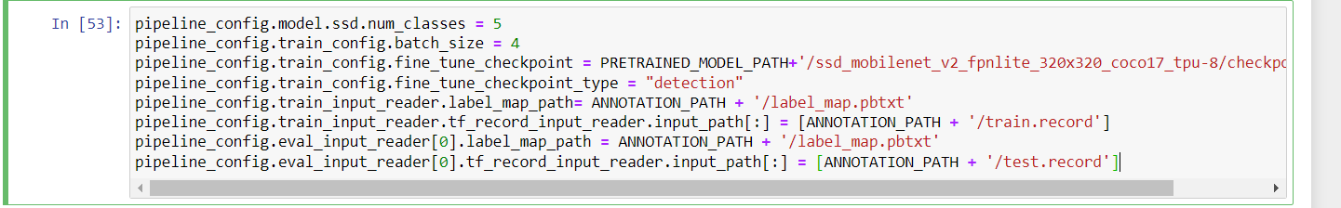
Configuring every pathway

Slide 26
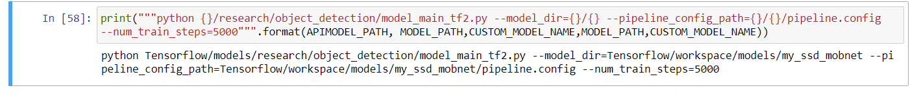
The final format is assigned

Slide 27
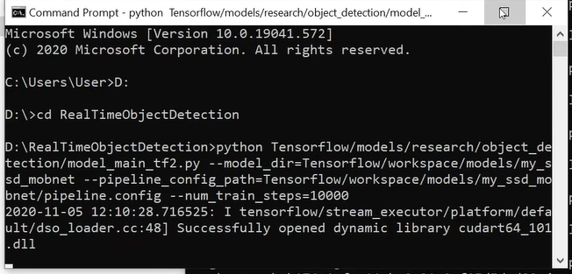
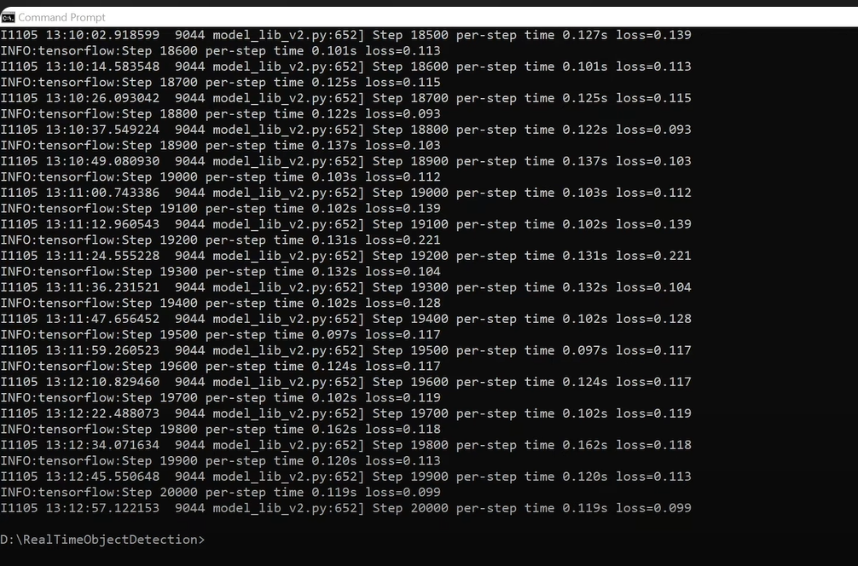
Testing the datas

Slide 28
Building a detection model

Slide 29
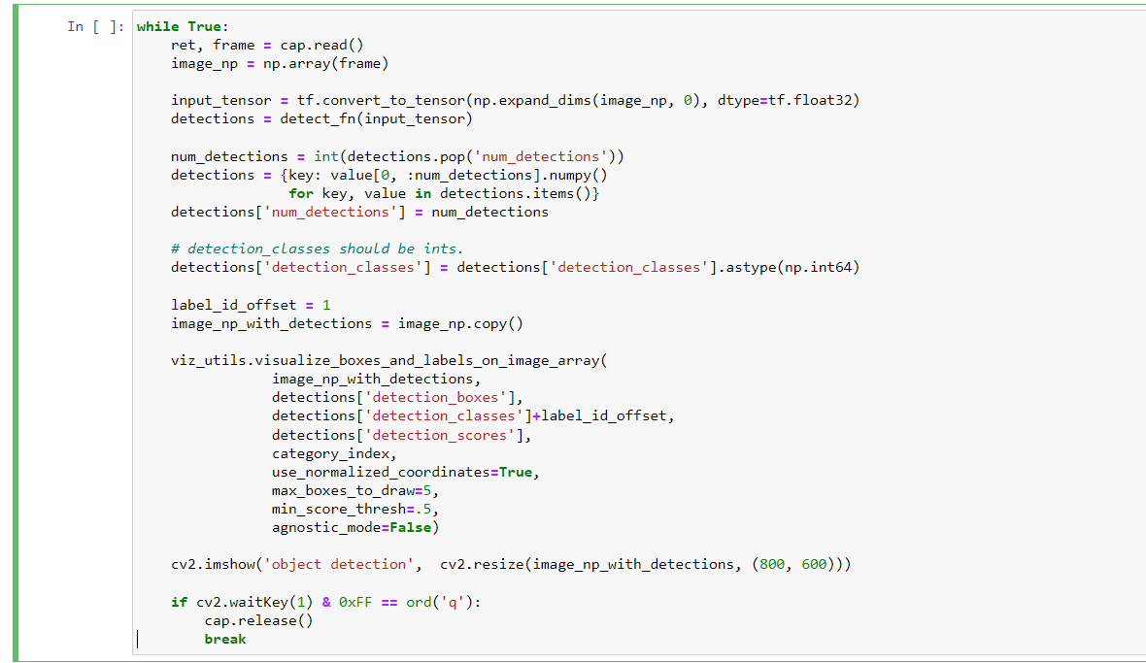
Detection model

Slide 30
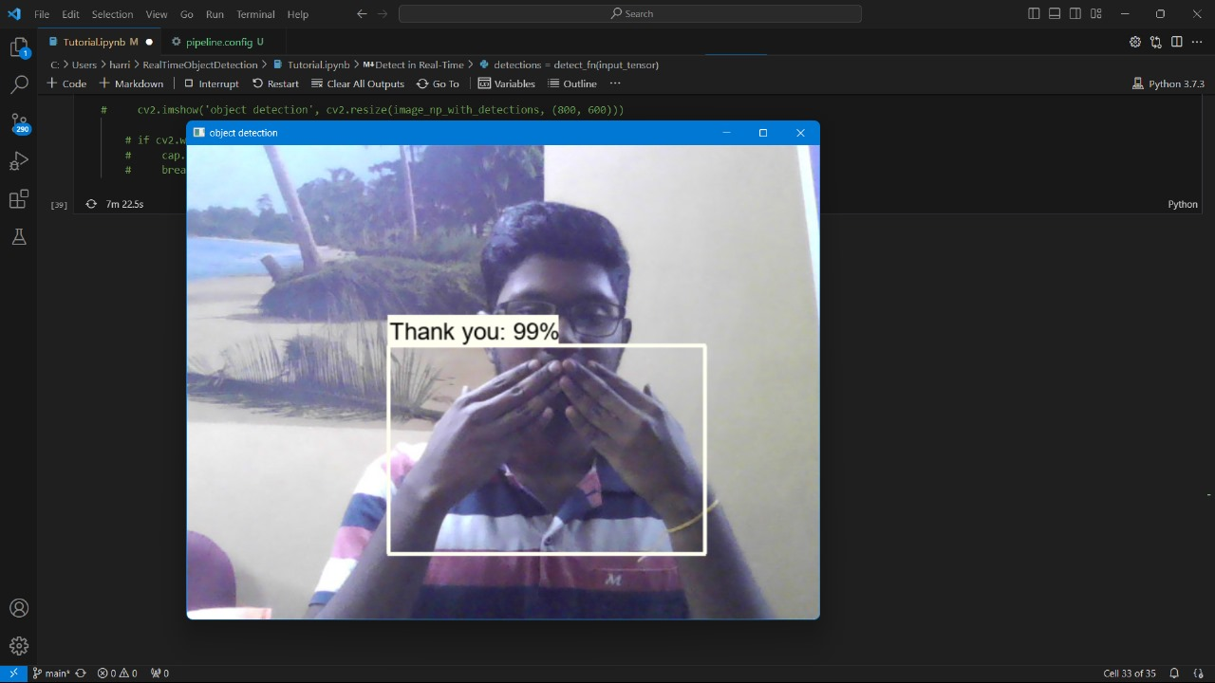
Result

Slide 31
Sign detection Challenges
Sign language does not use only hand gestures to communicate but also includes facial expressions, hand movements and positions and body posture.
Any change in them can change the entire meaning of the sign.
That is why it is generally hard for someone with no knowledge of sign language to understand them.
If the source of light from behind the student is too bright, there is a possibility of misclassification

Slide 32
References
1. Kapur, R.: The Types of Communication. MIJ. 6, (2020).
2. Suharjito, Anderson, R., Wiryana, F., Ariesta, M.C., Kusuma, G.P.: Sign Language Recognition Application Systems for Deaf-Mute People: A Review Based on InputProcess-Output. Procedia Comput. Sci. 116, 441–448 (2017). https://doi.org/10.1016/J.PROCS.2017.10.028.
3. Konstantinidis, D., Dimitropoulos, K., Daras, P.: Sign language recognition based on hand and body skeletal data. 3DTV-Conference. 2018-June, (2018). https://doi.org/10.1109/3DTV.2018.8478467.
4. Dutta, K.K., Bellary, S.A.S.: Machine Learning Techniques for Indian Sign Language Recognition. Int. Conf. Curr. Trends Comput. Electr. Electron. Commun. CTCEEC 2017. 333–336 (2018). https://doi.org/10.1109/CTCEEC.2017.8454988.
5. https://github.com/nicknochnack/RealTimeObjectDetection
6. https://github.com/HumanSignal/labelImg

Slide 33
THANK YOU
We thank our guide and panel and all technical and non technical staff helped us in achieving this.

